Slide 1
By
K PAVAN KUMAR
Dept. Of CSE
VFSTR University

Slide 2
YACC
YACC stands for Yet Another Compiler Compiler.
This program is designed to compile a LALR(1).
The input of YACC is the rule or grammar and the output is a C program.
Input: A CFG- file.y
Output: A parser y.tab.c (yacc)

Slide 3
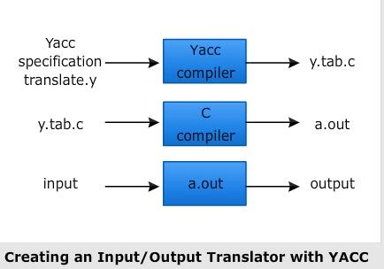
Representation

Slide 4
Structure of the YACC Prog
---------------------------------
Declaration Section
---------------------------------
% %
---------------------------------
Translation Rule Section
---------------------------------
% %
---------------------------------
Auxiliary Procedures Section
---------------------------------

Slide 5
Declaration Section :-
Contains the declaration for variables required
for YACC program.
Translation Rule Section :-
Contains the Rules/Grammars
Production { action 1 }
Production { action 2 }
Production { action 3 }
---------------------------------------
Production { action n }
Auxiliary Procedure Section :-
Contains all the procedures used in your C - code

Slide 6
Built-in Function
yyparse() :-
Used for calling syntax analyzer for given tranlation rules.
yyerror() :-
Displaying any error message.
yywrap() :-
It is used for taking i/p from more one file.

Slide 7
Built-in Types
%token:
Used to declare the tokens used in the grammar.
Eg :- %token NAME NUMBER
2) %start:
Used to declare the start symbol of the grammar.
Eg.:-%start stm
3) %left
Used to assign the associativity to operators.
Eg.:-%left '+' '-'

Slide 8
4) %right :-
Used to assign the associativity to operators.
5) %nonassoc :-
Used to unassociate.
Eg.:- %nonassoc UMINUS.
6) %prec :-
Used to tell parser use the precedence of the given code.
Eg.:- %prec UMIN
7) %type :-
Used to create the type of a variable.
Eg.:- %type <name of any variable>exp

Slide 9
Executing YACC programs follow the following steps-
1) Compile *.y file with yacc
# yacc –d *.y
It will generate y.tab.c and y.tab.h files.
2) Compile *.l file with lex command
# lex *.l
It will generate lex.yy.c file for your lexical
analyzer.

Slide 10
3) Compile and link lex.yy.c and y.tab.c file with cc command
# cc lex.yy.c y.tab.c
4) Execute the *.out file to see the output
# ./a.out

Slide 11
Thank You
Thank You

